Slide 1
Introduction to Direct Speech in Greek
Prof. Vanessa Gorman
University of Nebraska-Lincoln
vgorman1@unl.edu

Slide 2
Plato, Euthyphro 2a-c [Loeb translation from Perseus]
Euthyphro What strange thing has happened, Socrates, that you have left your accustomed haunts in the Lyceum and are now haunting the portico where the king archon sits? For it cannot be that you have an action before the king, as I have.
Socrates Our Athenians, Euthyphro, do not call it an action, but an indictment.
Euthyphro [2b] What? Somebody has, it seems, brought an indictment against you; for I don't accuse you of having brought one against anyone else.

Slide 3
First and Second Person Pronouns
Euthyphro What strange thing has happened, Socrates, that you have left your accustomed haunts in the Lyceum and are now haunting the portico where the king archon sits? For it cannot be that you have an action before the king, as I have.
Socrates Our Athenians, Euthyphro, do not call it an action, but an indictment.
Euthyphro [2b] What? Somebody has, it seems, brought an indictment against you; for I don't accuse you of having brought one against anyone else.

Slide 4
First and Second Person Verb Endings
Euthyphro What strange thing has happened, Socrates, that you have left your accustomed haunts in the Lyceum and are now haunting the portico where the king archon sits? For it cannot be that you have an action before the king, as I have.
Socrates Our Athenians, Euthyphro, do not call it an action, but an indictment.
Euthyphro [2b] What? Somebody has, it seems, brought an indictment against you; for I don't accuse you of having brought one against anyone else.

Slide 5
Direct Questions
Euthyphro What strange thing has happened, Socrates, that you have left your accustomed haunts in the Lyceum and are now haunting the portico where the king archon sits? For it cannot be that you have an action before the king, as I have.
Socrates Our Athenians, Euthyphro, do not call it an action, but an indictment.
Euthyphro [2b] What? Somebody has, it seems, brought an indictment against you; for I don't accuse you of having brought one against anyone else.

Slide 6
Direct address (vocative)
Euthyphro What strange thing has happened, Socrates, that you have left your accustomed haunts in the Lyceum and are now haunting the portico where the king archon sits? For it cannot be that you have an action before the king, as I have.
Socrates Our Athenians, Euthyphro, do not call it an action, but an indictment.
Euthyphro [2b] What? Somebody has, it seems, brought an indictment against you; for I don't accuse you of having brought one against anyone else.

Slide 7
Interjection
Socrates But, in the name of Zeus, Euthyphro, do you think your knowledge about divine laws and holiness and unholiness is so exact that, when the facts are as you say, you are not afraid of doing something unholy yourself in prosecuting your father for murder?

Slide 8
Summary of New Elements in Direct Speech
ExD = External Dependency
Interjections
Vocatives
Direct Questions
1st and 2nd Person Pronouns
1st and 2nd Person Verb endings
Commands and wishes [imperative, subjunctive, and optative moods]

Slide 9
ExD = External Dependency
Elements that stand apart from the syntax of the sentence
Often separated off using commas
1) Exclamations and interjections
Prepositional phrases and indeclinables
Curses [μὰ Δία]
2) Direct address = nouns in the vocative case
NOTE: short parenthetical remarks = AuxY
οἶμαι, εὖ ἴστε, etc.

Slide 10
Vocative Case
Usually preceded by “oh” = ὦ [indeclinable] AuxZ and set apart by commas
Usually looks like the nominative
In the plural, it always does [ὦ ἄνδρες, ὦ Ἀθηναῖοι, ὦ ἄνδρες δικασταί]
In the singular it does for 1st decl feminines, many 3rd declensions [ὦ βουλή, ὦ Θηράμενες]
Singular 2nd declension masculines end with –ε
ἵππος > ὦ ἵππε
ἄνθρωπος > ὦ ἄνθρωπε
Φαρνάβαζος > ὦ Φαρνάβαζε

Slide 11
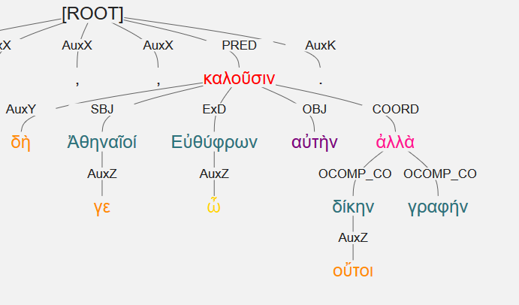
Vocative is labeled ExD
οὔτοι δὴ Ἀθηναῖοί γε, ὦ Εὐθύφρων, δίκην αὐτὴν καλοῦσιν ἀλλὰ γραφήν.
The Athenians, o Euthyphro, do not call it a private, but a public lawsuit.
οὔτοι = οὔ + τοι = indeed not
ΝΟΤ οὗτοι (those men)

Slide 12
Questions [Interrogatives]
Question mark = ;
Alternative questions demand a yes/no answer
ναί = yes; πάνυ = certainly; etc.
ἆρα introduces a neutral question
οὐκοῦν or ἂρ’ οὐ or just οὐ = expects a “yes” [Isn’t it true that…?]

Slide 13
Specifying Questions [CGCG 38.11] with accents
τίς; τί; [with accents] | Who? what? which? | πότε; | When?
τί; διὰ τί; | Why? | πῶς; | How?
πότερος; | Which of two? [Whether?]
 | LESS COMMON
πόσος; | How large? How many? | ποῖ; | To where?
ποῖος; | What sort of? | πῇ; | Along what route? How?
ποῦ; | Where? | πόθεν; | From where?

Slide 14
Person
A grammatical category used to classify word forms according to whether they refer to the speaker(s)/writer(s) (first person), the addressee(s) (second person), or a third party or parties (third person) [OED]
First person = I or we
Second person = you [singular or plural]
Third person = he, she, it, they

Slide 15
Review of αὐτός
In oblique cases, it is used for the 3rd person pronoun.
ἔλιπον αὐτήν ἐν τῇ Καρίᾳ =They left her in Caria.
In the predicate position, it means “self”
ὁ θεός αὐτὸς = the god himself
In the attributive position, it means “the same”
ὁ αὐτὸς θεός = the same god
When standing alone in the nominative, it emphasizes the subject
αὐτοὶ τὴν γῆν ἔσχον = They [the Athenians] held the land.
Emphasizes the unstated subject, Athenians. [Smyth 1206]

Slide 16
Personal Pronouns simplified
REVIEW: 3rd person pronoun is usually αὐτός in the oblique cases
Subject unnecessary unless emphasized or contrasted
Can use the article or, for emphasis, various demonstratives
Sign of the 1st person singular = μ [as in me]
Sign of the 2nd person singular = σ [as in second person]
Sign of the 1st person plural = ἡ [as in hey!]
Sign of the 2nd person plural = ὑ [as in you-hoo!]

Slide 17
Personal Pronouns (unemphatic)
First Person [μ and ἡ]
 | SING | PLUR
NOM | ἐγώ | ἡμεῖς
GEN | ἐμοῦ/μου | ἡμῶν
DAT | ἐμοί/μοι | ἡμῖν
ACC | ἐμέ/με | ἡμᾶς

Slide 18
Personal Pronouns (unemphatic)
First Person [μ and ἡ] Second Person [σ and ὑ]
1st and 2nd person singular unaccented if not emphasized
 | SING | PLUR
NOM | ἐγώ | ἡμεῖς
GEN | ἐμοῦ/μου | ἡμῶν
DAT | ἐμοί/μοι | ἡμῖν
ACC | ἐμέ/με | ἡμᾶς
 | SING | PLUR
NOM | σύ | ὑμεῖς
GEN | σοῦ/σου | ὑμῶν
DAT | σοί/σοι | ὑμῖν
ACC | σέ/σε | ὑμᾶς

Slide 19
Reflexive Pronouns
Refers back to the subject [therefore, no nominative]
ἑαυτοῦ, αὑτοῦ [ἑ + αὐτός]
Fοr first person, add ἐμ + αὐτός
For second person, σ(ε) + αὐτός

Slide 20
Reflexive Pronouns
Refers back to the subject [therefore, no nominative]
ἑαυτοῦ, αὑτοῦ [ἑ + αὐτός meaning “self”]
Fοr first person, add ἐμ + αὐτός
For second person, σ(ε) + αὐτός
 | 1st MASC SING | 1st FEM SING | 2nd MASC PLUR | 2nd FEM PLUR
NOM | -- | -- | -- | --
GEN | ἐμαυτοῦ | ἐμαυτῆς | σ(ε)αυτοῦ | σ(ε)αυτῆς
DAT | ἐμαυτῷ | ἐμαυτῇ | σ(ε)αυτῷ | σ(ε)αυτῇ
ACC | ἐμαυτόν | ἐμαυτήν | σ(ε)αυτόν | σ(ε)αυτήν

Slide 21
Reflexive Plurals
Use the plural pronouns and the forms of αὐτός as separate words
1st | PLUR
NOM | --
GEN | ἡμῶν αὐτῶν
DAT | ἡμῖν αὐτοῖς
ACC | ἡμᾶς αὐτούς

Slide 22
Reflexive Plurals
Use the plural pronouns and the forms of αὐτός as separate words
1st | PLUR
NOM | --
GEN | ἡμῶν αὐτῶν
DAT | ἡμῖν αὐτοῖς
ACC | ἡμᾶς αὐτούς
2nd | PLUR
NOM | --
GEN | ὑμῶν αὐτῶν
DAT | ὑμῖν αὐτοῖς
ACC | ὑμᾶς αὐτούς

Slide 23
Reflexive Plurals
Use the plural pronouns and the forms of αὐτός as separate words
1st | PLUR
NOM | --
GEN | ἡμῶν αὐτῶν
DAT | ἡμῖν αὐτοῖς
ACC | ἡμᾶς αὐτούς
2nd | PLUR
NOM | --
GEN | ὑμῶν αὐτῶν
DAT | ὑμῖν αὐτοῖς
ACC | ὑμᾶς αὐτούς
3rd | [Personal: Hdt] | PLUR
NOM | σφεῖς | --
GEN | σφῶν | σφῶν αὐτῶν
DAT | σφίσι | σφίσι αὐτοῖς
ACC | σφᾶς | σφᾶς αὐτούς

Slide 24
Possessive Adjectives
ἐμός, ἐμή, ἐμόν = my
σός, σή, σόν = your, yours (singular)
ἡμέτερος, -τέρα, τερον = our, ours
ὑμέτερος, -τέρα, τερον = your, yours (plural)
σφέτερος, -τέρα, τερον = their
All declined like regular 3-ending adjectives.

Slide 25
Verbs in Direct Speech In Greek

Slide 26
Verbs in Direct Speech
1st and 2nd person verb endings
Imperative Mood. “Go to war!”
Separate mood for commands in the 2nd and 3rd person
Independent Optative [emphasis on opt]
Potential (with ἄν). “We might go to war.”
Wish (without ἄν). “May we go to war!”
Independent Subjunctive [UNREAL]
Hortatory in 1st person [= commands in 1st person] “Let us go to war.”
Deliberative in 1st person questions. “Should we go to war?”
Prohibitive in 2nd person (with μή). “Do not go to war!”

Slide 27
Primary Active endings
PRESENT INDICATIVE | SINGULAR | PLURAL
1st person | λύω | λύομεν
2nd person | λύεις | λύετε
3rd person | λύει | λύουσι(ν)

Slide 28
Primary Active endings
PRESENT INDICATIVE | SINGULAR | PLURAL
1st person | λύω | λύομεν
2nd person | λύεις | λύετε
3rd person | λύει | λύουσι(ν)
FUTURE INDICATIVE | SINGULAR | PLURAL
1st person | λύσω | λύσομεν
2nd person | λύσεις | λύσετε
3rd person | λύσει | λύσουσι(ν)

Slide 29
Primary Active endings
PRESENT INDICATIVE | SINGULAR | PLURAL
1st person | λύω | λύομεν
2nd person | λύεις | λύετε
3rd person | λύει | λύουσι(ν)
PRESENT SUBJUNCTIVE | SINGULAR | PLURAL
1st person | λύω | λύωμεν
2nd person | λύῃς | λύητε
3rd person | λύῃ | λύσωσι(ν)

Slide 30
Primary Active endings
PRESENT INDICATIVE | SINGULAR | PLURAL
1st person | λύω | λύομεν
2nd person | λύεις | λύετε
3rd person | λύει | λύουσι(ν)
PRESENT SUBJUNCTIVE | SINGULAR | PLURAL
1st person | λύω | λύωμεν
2nd person | λύῃς | λύητε
3rd person | λύῃ | λύσωσι(ν)
PRESENT OPTATIVE | SINGULAR | PLURAL
1st person | λύοιμι | λύοιμεν
2nd person | λύοις | λύοιτε
3rd person | λύοι | λύοιεν

Slide 31
Secondary Active endings
PRESENT INDICATIVE | SINGULAR | PLURAL
1st person | λύω | λύομεν
2nd person | λύεις | λύετε
3rd person | λύει | λύουσι(ν)

Slide 32
Secondary Active endings
PRESENT INDICATIVE | SINGULAR | PLURAL
1st person | λύω | λύομεν
2nd person | λύεις | λύετε
3rd person | λύει | λύουσι(ν)
IMPERFECT INDICATIVE | SINGULAR | PLURAL
1st person | ἔλυον | ἐλύομεν
2nd person | ἔλυες | ἐλύετε
3rd person | ἔλυε(ν) | ἔλυον

Slide 33
Secondary Active endings
PRESENT INDICATIVE | SINGULAR | PLURAL
1st person | λύω | λύομεν
2nd person | λύεις | λύετε
3rd person | λύει | λύουσι(ν)
IMPERFECT INDICATIVE | SINGULAR | PLURAL
1st person | ἔλυον | ἐλύομεν
2nd person | ἔλυες | ἐλύετε
3rd person | ἔλυε(ν) | ἔλυον
2nd AORIST INDICATIVE | SINGULAR | PLURAL
1st person | ἦλθον | ἠλύθομεν
2nd person | ἦλθες | ἤλθετε
3rd person | ἦλθε(ν) | ἦλθον

Slide 34
Primary Middle/Passive Endings
PRESENT INDICATIVE | SINGULAR | PLURAL
1st person | λύω | λύομεν
2nd person | λύεις | λύετε
3rd person | λύει | λύουσι(ν)
PRESENT INDICATIVE | SINGULAR | PLURAL
1st person | λύομαι | λύομεθα
2nd person | λύει | λύεσθε
3rd person | λύεται | λύονται

Slide 35
Primary Middle/Passive Endings
PRESENT INDICATIVE | SINGULAR | PLURAL
1st person | λύω | λύομεν
2nd person | λύεις | λύετε
3rd person | λύει | λύουσι(ν)
PRESENT INDICATIVE | SINGULAR | PLURAL
1st person | λύομαι | λύομεθα
2nd person | λύει | λύεσθε
3rd person | λύεται | λύονται
PRESENT SUBJUNCTIVE | SINGULAR | PLURAL
1st person | λύωμαι | λυώμεθα
2nd person | λύῃ | λύησθε
3rd person | λύηται | λύωνται

Slide 36
Secondary Middle/Passive Endings
PRESENT INDICATIVE | SINGULAR | PLURAL
1st person | λύομαι | λύομεθα
2nd person | λύει | λύεσθε
3rd person | λύεται | λύονται
IMPERFECT INDICATIVE | SINGULAR | PLURAL
1st person | ἐλυόμην | ἐλυόμεθα
2nd person | ἐλύου | ἐλύεσθε
3rd person | ἐλύετο | ἐλύοντο

Slide 37
Secondary Middle/Passive Endings
PRESENT INDICATIVE | SINGULAR | PLURAL
1st person | λύομαι | λύομεθα
2nd person | λύει | λύεσθε
3rd person | λύεται | λύονται
IMPERFECT INDICATIVE | SINGULAR | PLURAL
1st person | ἐλυόμην | ἐλυόμεθα
2nd person | ἐλύου | ἐλύεσθε
3rd person | ἐλύετο | ἐλύοντο
1st AORIST INDICATIVE | SINGULAR | PLURAL
1st person | ἐλυσάμην | ἐλυσάμεθα
2nd person | ἐλύσω | ἐλυσάσθε
3rd person | ἐλύσατο | ἐλύσαντο

Slide 38
Summary of endings
 | Primary Αctive [Pres] | Secondary Active [Impf] | Primary M/P [Pres] | Secondary M/P [Impf]
1st sing | λύω | ἔλυον | λύομαι | ἐλυόμην
2nd sg | λύεις | ἔλυες | λύει | ἐλύου
3rd sg | λύει | ἔλυε(ν) | λύεται | ἐλύετο
1st pl | λύομεν | ἐλύομεν | λύομεθα | ἐλυόμεθα
2nd pl | λύετε | ἐλύετε | λύεσθε | ἐλύεσθε
3rd pl | λύουσι(ν) | ἔλυον | λύονται | ἐλύοντο

Slide 39
λύω and βάλλω [3PP = ἔβαλον; 6PP = ἐβλήθην]
1st AORIST INDICATIVE | SINGULAR | PLURAL
1st person | ἔλυσα | ἐλύσαμεν
2nd person | ἔλυσας | ἐλύσατε
3rd person | ἔλυσε(ν) | ἔλυσαν
2nd AORIST INDICATIVE | SINGULAR | PLURAL
1st person | ἔβαλον | ἐβάλομεν
2nd person | ἔβαλες | ἐβάλετε
3rd person | ἔβαλε(ν) | ἔβαλον
1st AORIST MIDDLE | SINGULAR | PLURAL
1st person | ἐλυσάμην | ἐλυσάμεθα
2nd person | ἐλύσω | ἐλυσάσθε
3rd person | ἐλύσατο | ἐλύσαντο
2nd AORIST MIDDLE | SINGULAR | PLURAL
1st person | ἐβαλόμην | ἐβαλόμεθα
2nd person | ἐβάλου | ἐβάλεσθε
3rd person | ἐβάλετο | ἐβάλοντο
AORIST PASSIVE | SINGULAR | PLURAL
1st person | ἐλύθην | ἐλύθημεν
2nd person | ἐλύθης | ἐλύθητε
3rd person | ἐλύθη | ἐλύθησαν
AORIST PASSIVE | SINGULAR | PLURAL
1st person | ἐβλήθην | ἐβλήθημεν
2nd person | ἐβλήθης | ἐβλήθητε
3rd person | ἐβλήθη | ἐβλήθησαν

Slide 40
Imperatives [2nd and 3rd only]
PRESENT ACTIVE | SINGULAR | PLURAL
1st person | hortatory subjunctive | hortatory subjunctive
2nd person | λῦε | λύετε [same as indic]
3rd person | λυέτω | λυόντων
PRESENT MIDDLE/PASSIVE | SINGULAR | PLURAL
1st person | hortatory subjunctive | hortatory subjunctive
2nd person | λύου | λύεσθε [same as indic]
3rd person | λυέσθω | λυέσθων

Slide 41
Sample Dependency Syntax Trees of Direct Speech
Prof. Vanessa Gorman
University of Nebraska-Lincoln
vgorman1@unl.edu

Slide 42
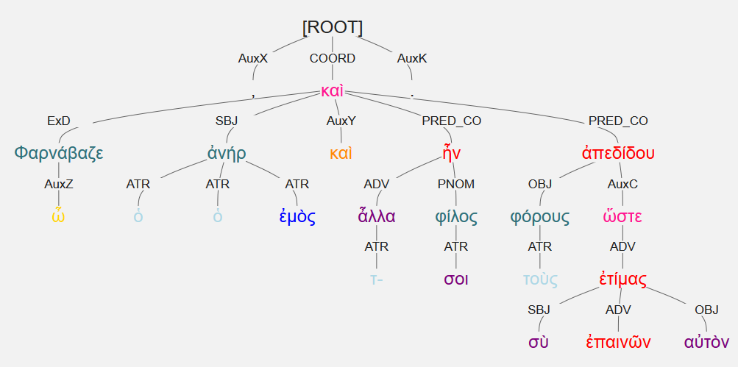
ὦ Φαρνάβαζε, ὁ ἀνήρ σοι ὁ ἐμὸς καὶ τ- ἆλλα φίλος ἦν καὶ τοὺς φόρους ἀπεδίδου ὥστε σὺ ἐπαινῶν αὐτὸν ἐτίμας. [Xen., Hell. 3.1.11]
“O Pharnabazos, my husband was a friend to you also in other respects, and he handed over tribute so that you honored him with praise.”

Slide 43
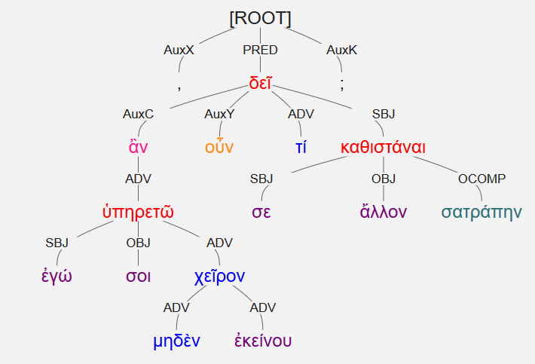
ἂν οὖν ἐγώ σοι μηδὲν χεῖρον ἐκείνου ὑπηρετῶ, τί σε δεῖ ἄλλον σατράπην καθιστάναι; [Xen., Hell. 3.1.11]
“If then I serve you in no way less than he did, why is it necessary for you to make someone else satrap?”

Slide 44
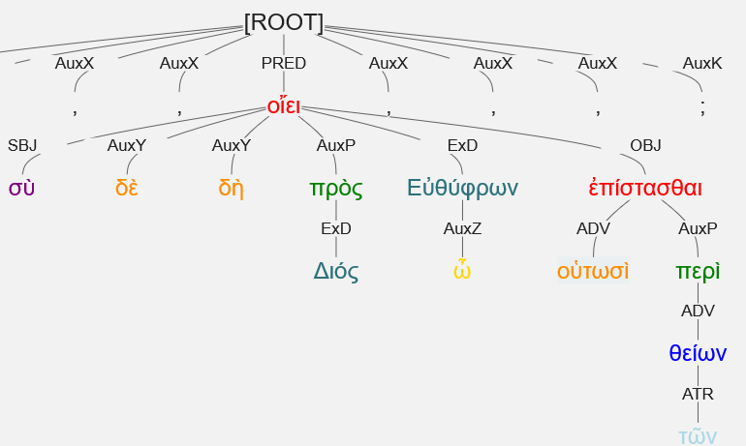
σὺ δὲ δὴ πρὸς Διός, ὦ Εὐθύφρων, οὑτωσὶ ἀκριβῶς οἴει ἐπίστασθαι περὶ τῶν θείων. [Plato, Euthyphro 4e]
“You truly, by Zeus, o Euthyphro, think that you know thus accurately concerning divine matters.”

Slide 45
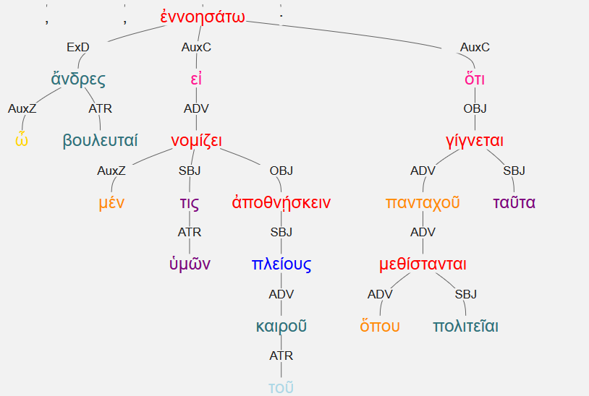
ὦ ἄνδρες βουλευταί, εἰ μέν τις ὑμῶν νομίζει πλείους τοῦ καιροῦ ἀποθνῄσκειν, ἐννοησάτω ὅτι ὅπου πολιτεῖαι μεθίστανται πανταχοῦ ταῦτα γίγνεται · [Xen., Hell. 2.3.24]
“O men of the Council, if any of you think that more people are dying than is proper [καιρός], consider that these things happen wherever constitutions are changed.”
ἐννοησάτω = 3rd sg act aor imperative

Slide 46
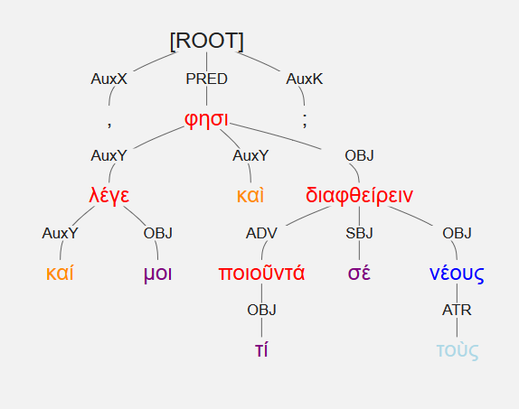
καί μοι λέγε, τί καὶ ποιοῦντά σέ φησι διαφθείρειν τοὺς νέους; [Plato, Euthyphro 3a]
“Tell me, did they say what you were doing when you corrupted the young men?”
Imperative introducing direct speech/questions
Hang as an AuxY. [He said”; “Tell me”]

Slide 47
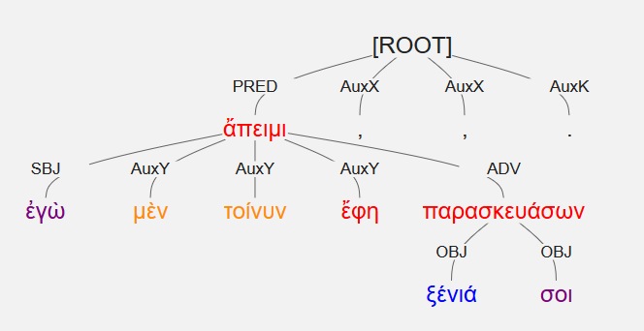
ἐγὼ μὲν τοίνυν ἄπειμι, ἔφη, ξένιά σοι παρασκευάσων. [Xen., Hell. 3.1.24]
“Now I am going away,” he said, “in order to prepare guest-gifts for you.”
Note: Future participle implying purpose.

Slide 48
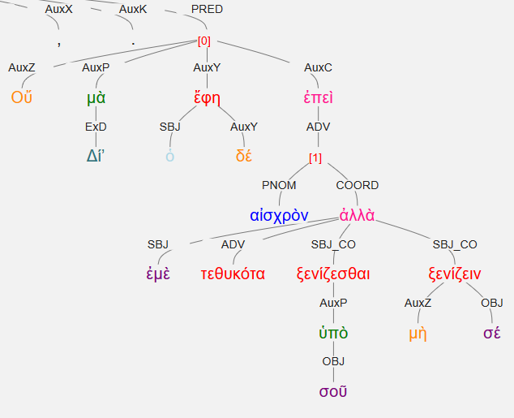
ὁ δέ, Οὔ, μὰ Δίʼ, ἔφη, ἐπεὶ αἰσχρὸν ἐμὲ τεθυκότα ξενίζεσθαι ὑπὸ σοῦ, ἀλλὰ μὴ ξενίζειν σέ. [Xen., Hell. 3.1.24]
And he said, “No, by Zeus, since it would be shameful for me, having just made a sacrifice, to be entertained by you, and to entertain you.”

